Slide 1
Harmonization Workshop

Slide 2
agenda
Welcome and Introductions
Overview of 90 Day Harmonization
Break
Harmonization Best Practices
Harmonization Tools Demo
Break
Community Discussion on Facilitating Harmonization Continuously and Harmonizing Outside of NIEM
Wrap-Up

Slide 3
Welcome & introductions

Slide 4
Welcome and introductions
Name
Organization
Domain
Why did you come to the workshop?
What do you hope to get out of today?

Slide 5
90 day harmonization (Michelle Vidanes)

Slide 6
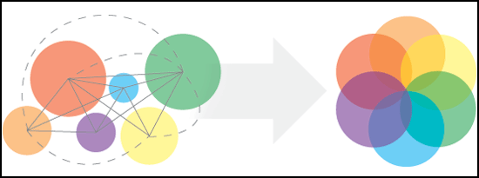
What is harmonization?
Harmonization is the process of examining the model to ensure that a given data element exists only once. Additionally, harmonization ensures that data elements are defined precisely and unambiguously, so that they are reusable across domains and the NIEM community.

Slide 7
Harmonization timeline
Completed
On Track
At Risk
Not Started
Intent to Submit Content (09/14/12)
Emerging Domain Roundtable (TBD)
NIEM 3.0 Kick-off (08/29/12)
Deadline for Code List Updates (11/1512)
90 Day Timeline Elapses (11/30/12)
Harmonization Workshop (09/18/12)
NIEM 3.0 Kick-off
(08/29/12)
Emerging Domain Roundtable
(TBD)
90 day timeline for all significant domain and NBAC content input commences
Brings emerging domains together to share lessons learned and seek advice for overcoming challenges
Deadline for each domain steward to declare intent to submit NIEM 3.0 content, by:
Opening NCCT issue in General Forum http://tools.niem.gov/ncct/ (preferred).
Emailing to niem-comments@lists.gatech.edu (GTRI will record NCCT issue)
Intent to Submit Content
(09/14/12)
Deadline for Code List Updates
(11/15/12)
Deadline for all code lists to be submitted to GTRI to be included in 3.0 Release
All domain/NBAC input to NIEM 3.0 from change requests and new content MUST QUALIFY by this date
Content that cannot meet the deadline will be pushed to next spiral release (e.g. beta1), a future release (e.g. 3.1), or PMO may slip the schedule day-for-day
Harmonization Workshop
(09/18/12)
90 Day Timeline Elapses
(11/30/12)
The workshop is designed to increase knowledge and understanding of the harmonization process

Slide 8
Harmonization process
2. Issue Triage
3. Tiger Team Working Session
4. Issue Resolution
1. Issue Identification
Issue identified and entered into the online NCCT tool
GTRI conducts initial assessment on new issues and prepares and distributes harmonization meeting agenda containing issue and brief description
Issue triaged and “assigned” to applicable participants
During the harmonization call, the issue is reviewed by all participants and assigned to a tiger team consisting of NBAC member(s) with knowledge, expertise, or vested interest in the issue resolution
Issue resolution worked by tiger team
The tiger team works offline to resolve the issue and posts the recommended resolution in NCCT
Proposed resolution is evaluated
The recommended resolution is reviewed by the NBAC and or accepted, rejected, or deferred for more information during the harmonization call

Slide 9
Harmonization responsibilities
NBAC Responsibilities
Domain Responsibilities
Resolve backlog of NBAC NCCT content issues
Harmonize when Core components are involved
Assist domains with harmonization and content modeling in collaboration with GTRI
Execute cross-domain harmonization, Core harmonization, and resolve associated NCCT issues as needed
Review and act on harmonization master list (HML) in NCCT issue #326
Prepare new content and changes XSD or CR format and submit for 3.0
Review their domain intermediate release content (names, definitions, structures, semantics)

Slide 10
15 minute break

Slide 11
Harmonization best practices

Slide 12

NIEM 3.0 Harmonization
DHS Domain Best Practices
^{(Mike Simcock)}

Slide 13
Forming the Harmonization Group
Identify potential subject matter experts
Re-engage existing domain experts
If none exist, what organizations are impacted by this work and is there a data SME or information exchange developer who can be contacted
Provide the group with a starting point
Build a strawman deck of outstanding issues, desired outcomes and milestone dates
Send out an invitation asking for open dates and include the deck
Finding a date that works for everyone is critical for continued attendance
Identify a meeting leader or Facilitator
Keeps the meeting focused and moving forward

Slide 14
Proposed Working Group Structure
For example , DHS SMEs from Immigration, Screening, Trade and interested parties (impacted domains)
Use HSIN Web Connect or WebEx as much as possible to do collaborative meetings
Meet Biweekly or as often as possible to get started, send out working documents ahead of time
Submit discussion items at least the day before but preferably the prior Friday
Encourage participation and group discussion
Solutions must be agreed to and documented

Slide 15
Develop a tracking worksheet
Critical to keep the group aware of progress and milestones
Send out the worksheet before each meeting
Update with group approval for solutions

Slide 16
Develop a Proposed Timeline Roadmap

Slide 17
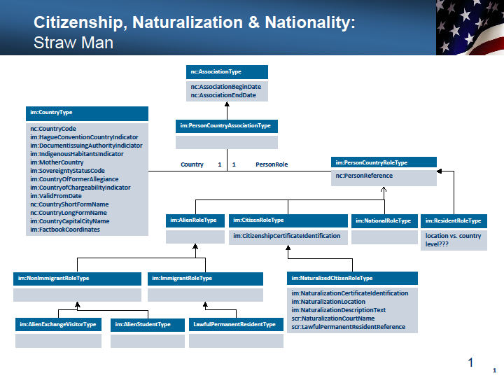
Use Magic Draw, Visio or some other tool for Modeling a solution

Slide 18
Develop a CMT for results
Update NCCT with solutions
Update Mapping Template with solutions
Review with group before submitting
ChangeID | Change Summary | Change Description | ChangeParentID | Default Change Entry (Mark only one as TRUE)
1 | nc:PersonUnionAssociationType | Update NIEM Core's Person Union Association to integrate Imm, Scr, and CYFS augmentations and other data requirements identified by the harmonization tiger team
2 | nc:CivilUnionAssociation | Delete, replaced with item in Person Union Category Code
3 | nc:DomesticPartnershipAssociation | Delete, replaced with item in Person Union Category Code
4 | nc:MarriageAssociation | Delete, replaced with item in Person Union Category Code
5 | nc:PersonUnionCategory | Update to an abstract substitution head for PersonUnionCategoryCode (w/ list) and PersonUnionCategoryText (a narrative description option)
6 | nonauth:MarriageCategoryCodeSimpleType | Rename PersonUnionCategoryCodeSimpleType, and update to change "married" to "marriage" and to add "domestic partnership"
7 | nc:PersonUnionCategoryText | Add as narrative description option for nc:PersonUnionCategory
7 | nc:PersonUnionStatus | Update to an abstract substitution head for PersonUnionStatusCode (w/ list) and PersonUnionStatusText (a narrative description option)
8 | nonauth:MarriageStatusCodeSimpleType | Rename PersonUnionStatusCodeSimpleType, and update to change "divorced" to "dissolved" and to add "annulled"
9 | nc:PersonUnionStatusText | Add as narrative description option for nc:PersonUnionStatus
10 | nc:PersonUnionLocation | Add as element of nc:PersonUnionAssociationType
11 | nc:PersonUnionNumeric | Add as element of nc:PersonUnionAssociationType
12 | nc:PersonUnionCertificateIndicator | Add as element of nc:PersonUnionAssociationType
13 | nc:PersonDisunion | Add as element of nc:PersonUnionAssociationType
14 | nc:PersonDisunionCertificateIndicator | Add as element of nc:PersonDisunion
15 | nc:PersonDisunionPendingIndicator | Add as element of nc:PersonDisunion
16 | nc:PersonDisunionReasonDescriptionText | Add as element of nc:PersonDisunion
17 | nc:PersonUnionSeparation | Add as element of nc:PersonUnionAssociationType
18 | nc:PersonUnionSeparationCategory | Add as abstract substitution group head for nc:PersonUnionSeparationCategory Code (w/ list) and nc:PersonUnionSeparationText (a narrative option)
19 | nonauth:PersonUnionSeparationCategoryCode | Add enumeration: legal, physical, unknown
20 | nc:PersonUnionSeparationText | Add as narrative description option for nc:PersonUnionSeparation
21 | nc:PersonUnionSeparationBeginDate | Add as element of nc:PersonUnionSeparation
21 | nc:PersonUnionSeparationEndDate | Add as element of nc:PersonUnionSeparation
22 | fs:MarriageAssociation | Delete this augmentation of nc:PersonUnionAssociationType
23 | im:MarriageAssociation | Delete this augmentation of nc:PersonUnionAssociationType
24 | scr:MarriageAssociation | Delete this augmentation of nc:PersonUnionAssociationType

Slide 19
Q&A
Questions, Comments, Concerns

Slide 20
Domain Harmonization Project International Trade – Maritime - CBRN
A NIEM Harmonization Story
(Bill Wright)

Slide 21
Agenda
Background
Project Overview
Cost & Schedule Aspects
Harmonization Process & Products
Lessons Learned

Slide 22
Background
IT/M/CBRN mission areas are inter-related
Concerned with “cargo” and “conveyances”
Cross mission area need for data-sharing will result in need for interoperable IEPDs
IT and CBRN had previously harmonized as part of the NIEM 2.1 release
Discussions between the domain stewards at the NIEM training event early Oct 2009 led to agreement to conduct a 3-way harmonization

Slide 23
Project Overview
Project Period: 30 Oct 2009 – Mar 2010
Types/Properties harmonized
NIEM hazmat.xsd codelist added to project at request of NBAC – 3 codelists developed
Conveyance Types deferred to the future
 | Types | Properties | Total
IT | 7 | 85 | 92
M | 5 | 46 | 51
CBRN | 1 | 3 | 4
Harm. | 8 | 98 | 106

Slide 24
Cost & Schedule
Schedule
Bi-weekly meetings held Oct 2009 to Feb 2010
Completion of harmonization agreements by end of Feb 2010
Cost (estimated & actual labor hours) – desired to track and report, but did not happen

Slide 25
Harmonization Process & Products
Agreed-to at Project Start
Harmonization Project Goals
General Process
Completion Criteria & Deliverables

Slide 26
Project Goals
Identify & harmonize selected data types/properties where semantic overlap or conflict exists
Identify additional types to be considered for a repeat effort if the first is successful
Identify types/properties that should be considered for harmonization with NIEM Core v3.0

Slide 27
General Process
Work virtually – no F2F meetings required
Time-box – don’t try to do everything in one effort
For first iteration, select 1 or 2 types with high semantic match for a 1st pass to iron out the process
Map the type properties (spreadsheet) – identify proposed changes
Conduct on-line sessions to discuss and agree on harmonization – capture and document agreements
Select from remaining types for next iteration – divide the work – iterate the process

Slide 28
Completion Criteria & Deliverables
CMT for mapping as-is to the to-be types/elements
Change log for the agreed-to changes made to each domain
List of types recommended for NIEM Core harmonization
List of candidate types for future harmonization efforts

Slide 29
Lessons Learned
Publish minutes of the team meetings for review of issues encountered during the project and to keep all informed
Need for selection criteria
Should all types with semantic overlap be harmonized?
When should types not be harmonized?
Should you/how do you → assess cost/benefit ?
How to gauge impact of harmonization on existing IEPDs?
Without good guidelines for selecting types for harmonization, experience and intuition of the harmonization team members is essential, but guidelines on when to stop are needed
Need criteria for domain placement of harmonized types/properties
Include domain update submission and release in the project
Need to provide business rationale for harmonization to engage management support
Need for method to estimate expected cost of a harmonization project
Domains need documentation

Slide 30
KISS
Keep it Simple
Harmonization is essentially a intellectual effort requiring domain SME’s
Tools don’t have the ability to do the SME’s thinking for them

Slide 31
Harmonization Best Practices (Deborah Brooks)

Slide 32
NIEM Domain Harmonization Best Practices
A visual representation, such as a UML Diagram, is essential for formulating, communicating and vetting recommended solutions.
One tiger team member should be the primary UML modeler, and may be assisted by another member of the tiger team to formulate the recommended solution that addresses the information exchange requirements.
The other tiger team members should identify their information exchange requirements for inclusion in the recommended solution, and vet it for completeness, accuracy, stability and extensibility to support anticipated future requirements.
Time between tiger team meetings should not exceed 2 weeks to maintain understanding of the recommended solution and avoid loss of momentum.

Slide 33
Harmonization tools demo

Slide 34
OpenII DEmo (Deborah Brooks)

Slide 35
OpenII Overview
OpenII is a collaborative effort, spearheaded by the MITRE Corporation, to create a suite of open-source tools for information integration.
The OpenII Harmony tool was used in the Domain Redundancy Identification Proof of Concept to match the contents of the NIEM Immigration and Screening domains.
The Domain Management best practices presented in this document assumes a familiarity with the OpenII tools listed above, MS-Excel and Schema Central, an interactive tool to traverse and search XML schemas (www.schemacentral.com). It is not intended to be a step-by-step user tutorial on how to operate these tools; it is intended to provide guidance in using the tools in performing the specific domain management tasks of identifying domain redundancies and BIECs. For OpenII operating instructions, the user is encouraged to view the tool documentation and FAQs provided in the OpenII user interface.

Slide 36
Methodology for Identifying Domain Redundancies
1. Matching
Import NIEM Immigration and Screening schemas into OpenII.
Run Matchers in Harmony to generate match scores.
Export Mapping in MS-Excel format.
2. Discovery
Open Mapping in MS-Excel.
Sort and filter to cluster strong matches.
Examine clusters to identify topics containing redundant terms and concepts.
3. Confirmation
Search on terms and concepts in Harmony to identify related Types and Elements.
Open NIEM 2.1 in Schema Central (schemacentral.com).
Confirm involved Types and Elements for an area of redundancy through searches and Used in/Used by link navigation.
4. Documentation
Construct UML diagrams depicting involved Types and Elements.

Slide 37
Best Practices - Matching
Import NIEM Immigration and Screening schemas into OpenII
Use latest version of OpenII at SourceForge.net.
Use XSD Importer Separate when importing NIEM schemas so that the components of each NIEM schemas are imported as separate Schemas (e.g. (intel)ligence, (j)ustice).
Create a Project, add the Immigration and Screening component Schemas that contain the Complex Object Types and Association Types add a Mapping of the two Schemas.
Run matchers in Harmony to generate match scores.
Open the Mapping in Harmony, Alphabetize the view, Set Focus on Complex Object Type (COT) and Association Type in each Schema, and expand these Types to show Elements.
Run Voter Merger matcher, select Custom Matchers, use default Matchers, choose Match by Type – Entity matching option.
Save Project to preserve matches.
Export Mapping in MS-Excel format.
Use MS-Excel Exporter 2 to export Mapping so that all matched and unmatched entities from both Schemas are exported.

Slide 38
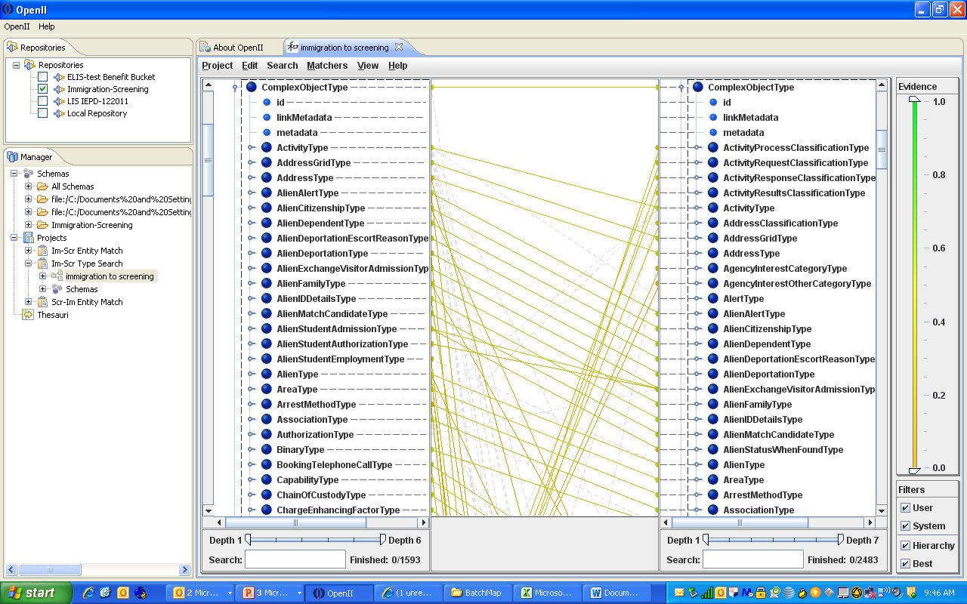
Example – Matching (Harmony)

Slide 39
Best Practices - Discovery
Open Mapping in MS-Excel.
Sort and filter to cluster strong matches.
Hide Source and Target Elements and Documentation (columns B, C, E and F).
Sort A-Z on Source Type (column A), Largest to Smallest on Score (column G).
Filter out/exclude Source Types (column A) “[root]” and names containing text “Code” to hide extraneous matches.
Filter out/exclude Target Types (column D) names containing text “Code”.
Filter/include Scores (column G) greater than 0.6 (level may be higher or lower depending on the schemas being compared).
Examine clusters to identify topics containing potentially redundant terms and concepts.
For example, the topic Marriage contains the following terms: Marriage, Union, Family.

Slide 40
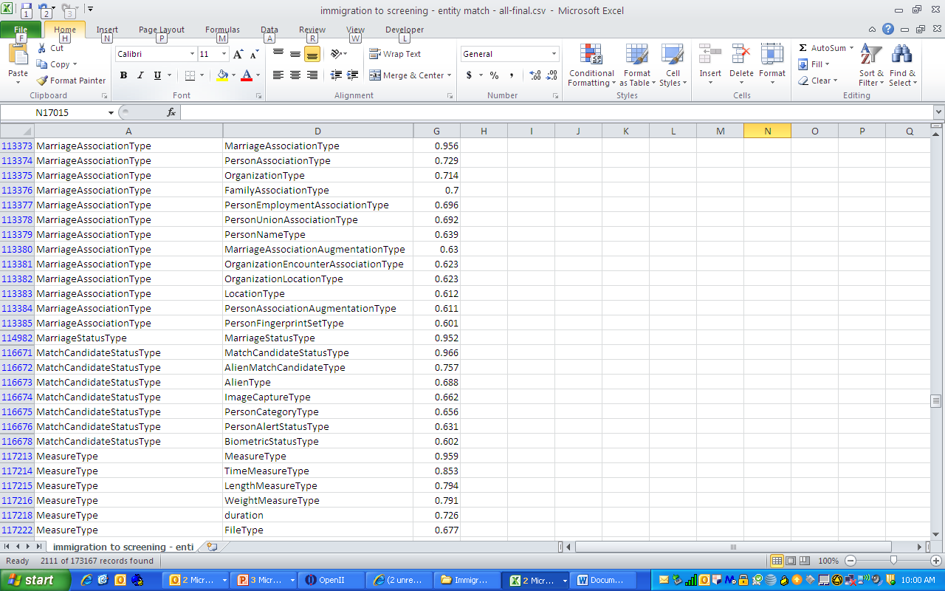
Example – Discovery (MS-Excel)

Slide 41
Best Practices - Confirmation
Search on terms and concepts in Harmony to identify related Types and Elements.
Open Mapping in Harmony, expand COT and Association Type to show Elements.
Search on keywords (e.g. Marriage); Types and Elements containing that keyword (either in its name or definition) will be highlighted and scroll bars will show location of selected items within Schemas.
Open NIEM 2.1 in Schema Central (schemacentral.com).
Confirm involved Types and Elements for an area of redundancy through searches and Used in/Used by link navigation.
Search on name of Type (e.g. MarriageAssociationType) or Element (e.g. SpouseRoleCode).
Explore Used In/Used By links in Schema Central to identify all involved Types and Elements.
Consolidate involved Types and associated Elements by copying and pasting Schema Central entries into a Word document.

Slide 42
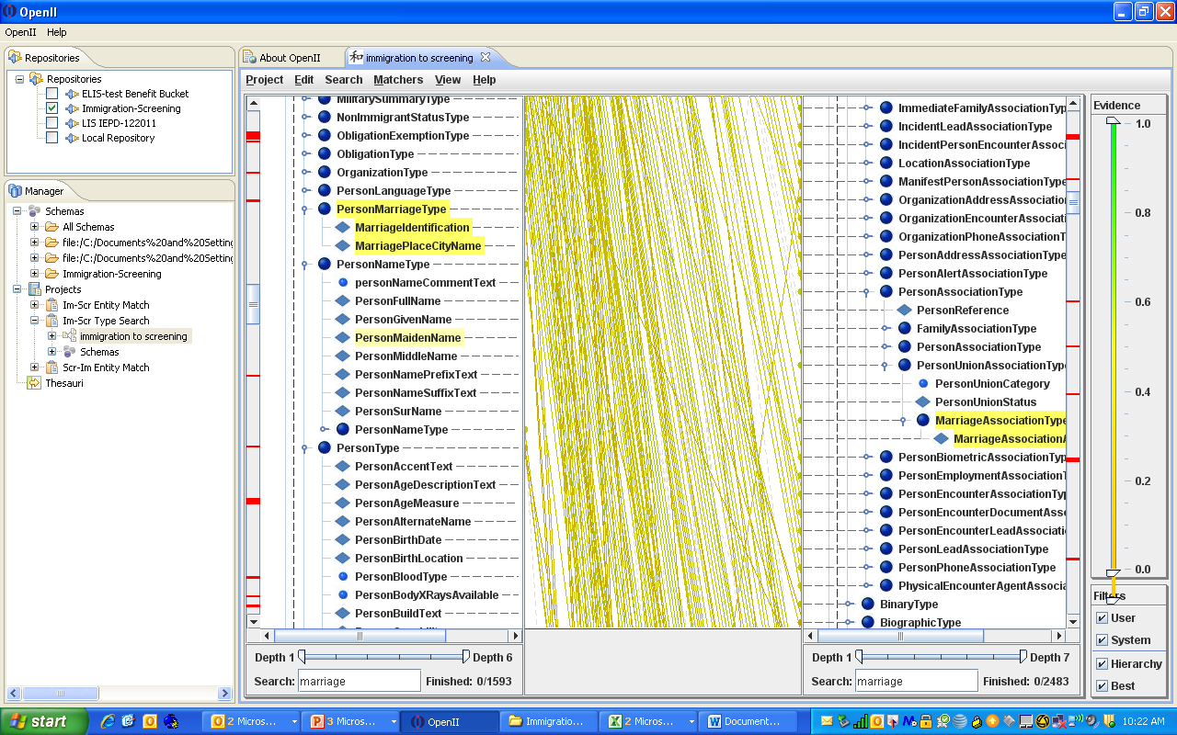
Example – Confirmation (Harmony)

Slide 43
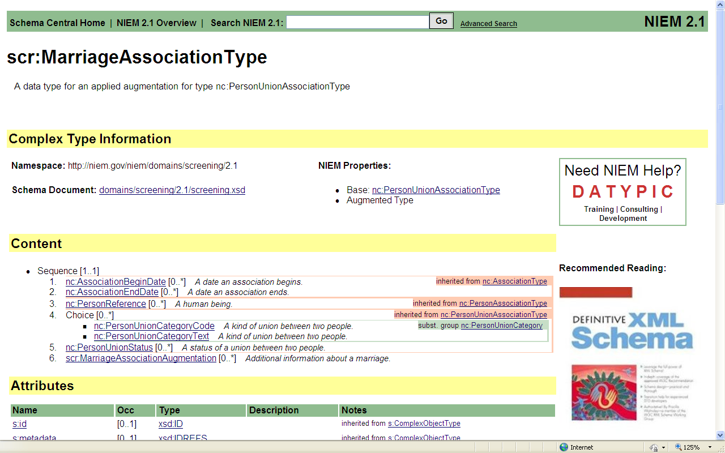
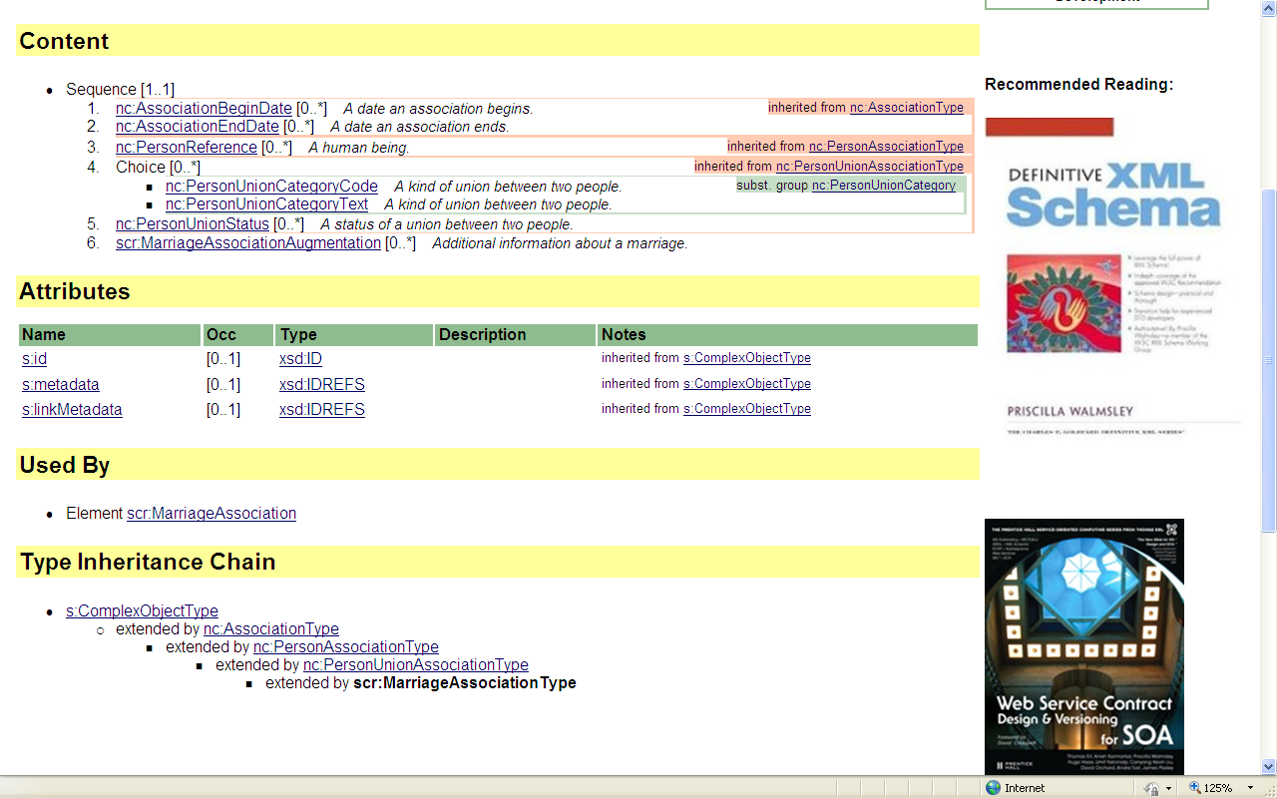
Example – Confirmation (Schema Central)

Slide 44
Best Practices - Documentation
Construct UML diagrams depicting involved Types and Elements.
Following the Type Inheritance Chain (in Schema Central) for each involved type, construct a UML diagram in Visio, PowerPoint or other graphic display tool.
The reverse engineering capabilities of NIEM UML Profile may provide automated support for the construction of UML diagrams. The NIEM UML Profile was not used in this Proof of Concept study because it had not yet been released for general use at the time this study was performed.

Slide 45
Example – Documentation
nc:ComplexObjectType
nc:AssociationType
nc:AssociationBeginDate nc:AssociationEndDate
nc:PersonAssociationType
nc:PersonReference
nc:PersonType
nc:PersonMaritalStatusText
scr:PersonAssociationType
scr:PersonAssociationCategoryCode scr:PersonAssociationCategoryDescriptionText
im:PersonType
im:PersonMarriage
im:AlienType
nc:RoleofPersonReference im:AlienFamilyMembers im:MaritalStatusCode
scr:FamilyAssociationType
scr:FamilyAssociationCategoryCode scr:FamilyAssociationCategoryDescriptionText
nc:StatusType
nc:PersonUnionAssociationType
nc:PersonUnionCategory nc:PersonUnionStatus
im:AlienFamilyType
im:AlienSpouse
im:PersonMarriageType
im:MarriageIdentification im:MarriagePlaceCityName
im::MarriageStatusType
nc:PersonUnionStatusCode
scr:MarriageAssociationType
scr:DivorceDecreeIndicator scr:MarriageCertificateIndicator scr:MarriageNumeric scr:MarriageCityName
im:MarriageAssociationType
im:SpouseRoleCode im:PersonMarriageEndReasonText im:PersonMarriageEndReasonDescriptionText im:MarriageDateRange im:PersonMarriageLocation
Area of Redundancy: Marriage

Slide 46
NIEM Harmonization with NIEM-UML Cory Casanave, Model Driven Solutions

Slide 47
Introduction
Agenda
Overview: Model driven information sharing with NIEM-UML
Example using Magicdraw UML tool and GANGS model
Basic Premise: You can only harmonize what you comprehend. NIEM-UML helps you comprehend NIEM, refactor it, and then generate the XML artifacts
BUT: It is no magic bullet; there is substantial work to understand and refactor these models.

Slide 48


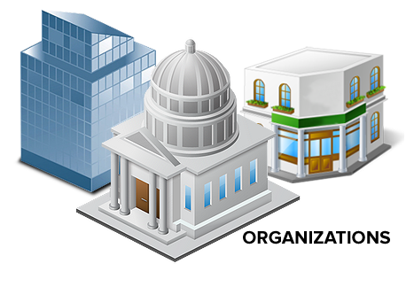



Information sharing People Vs. bits & bytes
Manual
Production
XML data “on the wire”
Notes:
People and organizations think about the information they need to share
ʘ NIEM at the XML level defines the structure of “data on the wire” using XML technologies
Worrying about business information needs along with the bits and bytes of hundreds of technology rules ʘ can get complicated and requires that technical specifications be manually produced

Slide 49
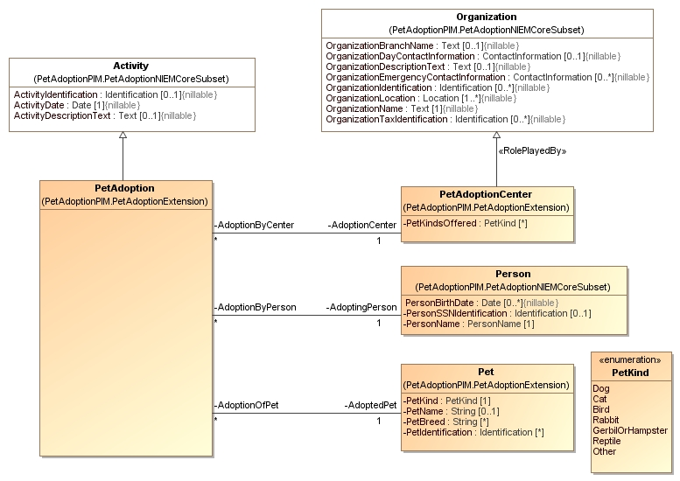


Information sharing based on NIEM-UML
NIEM-UML
Automatic
Generation
w/ NIEM UML
XML data “on the wire”
Notes:
NIEM-UML helps address the complexities of information sharing technologies
ʘ UML provides high-level information models
That are easier for people and organizations to understand
ʘ Tools automatically generate the bits and bytes needed for on-the-wire specifications based on the NIEM-UML standard
ʘ The way NIEM-UML is modeled and generates technology specifications is based on the model driven architecture standards of the object management group

Slide 50




UML (unified modeling language) is an OMG standard
Domain Concepts
NIEM-UML extends and tailors the unified
modeling language (OMG standard)
MODELS
NIEM-UML
Profile
NIEM-UML Tools
NIEM Exchange
Notes:
UML, the unified modeling language, is the OMG standard on which NIEM-UML is based
Modeling for NIEM is defined using the built-in extension mechanisms of UML
ʘ This is called a UML “profile”.
ʘ The NIEM-UML profile extends and tailors UML to fully model NIEM information concepts as understood by stakeholders
ʘ Another part of the NIEM-UML specification, the transforms, define how tools produce NIEM technical specification from NIEM-UML models as well as how to convert technical specifications into models – providing for “round trip” engineering.

Slide 51
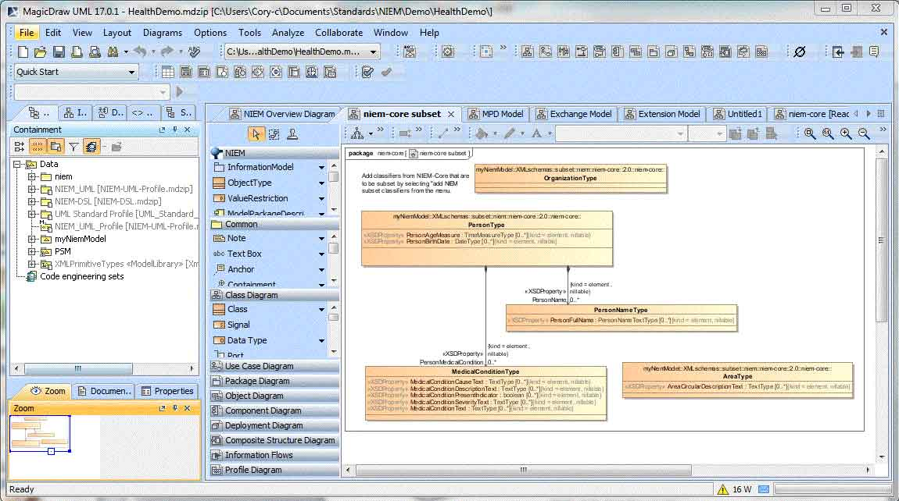
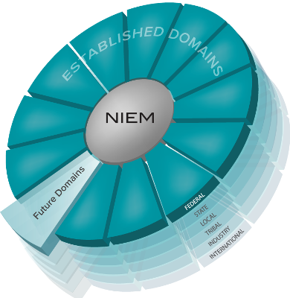
Using niem-uml to model information exchanges
NIEM-UML Information Exchange Model
NIEM-UML
Profile
Design and Model
XML data “on the wire”
Notes:
Using the NIEM-UML profile with UML modeling tools, ʘ domain experts combine their own unique needs with the ʘ NIEM reference vocabularies to ʘ design information exchange models that will ultimately produce NIEM information exchange packages that power XML“on the wire” technologies

Slide 52

Using niem-uml to Define new or Revised Reference Models
NIEM-UML
Profile
Design and Model
Notes:
In the same way, NIEM-UML can help ʘ users create new ʘ domain vocabularies that will ʘ extend NIEM, domains created with NIEM-UML will have both a UML and XML representation

Slide 53
NIEM - uml summary
NIEM-UML is a new NIEM specification that provides for modeling NIEM in UML and producing or reverse engineering information exchange technical specifications using Model Driven Architecture
This reduces the time, cost and learning curve of information exchange using NIEM
MDA also provides for other aspects of the information sharing solution, such as: business processes, SOA services and back-end system integration
Since NIEM-UML generates 100% NIEM conformant technical specifications, NIEM-UML Architects and Developers don’t need to worry about as much about the technology details
NIEM-UML can be extended to support other technologies, such as JSON and the semantic web
NIEM-UML has been adopted by the OMG, tools are available now and more are being built
Notes:
Watch the monitor – one click per line

Slide 54
Strawman Harmonization Methodology (Iterative)
Start with the NIEM-UML Representation of the current reference models
Create concept-centric diagrams that show an integrated view across the models
This makes the redundancy, contradictions and unnecessary complexity very obvious
Mark the issues in the model and prepare them for stakeholder review
Review issues and candidate solutions with stakeholders
Refactor the models in NIEM-UML
Regenerate reference model XSD and Documentation from the UML representation

Slide 55

Example “GANGS” Model Using Magicdraw

Slide 56

Information on NIEM-UML
http://niem-uml.org
Information on Magicdraw’s Cameo NIEM-UML Product
http://www.nomagic.com/products/magicdraw-addons/cameo-niem-plugin.html
Notes:
Thank you for your interest in NIEM-UML
Additional information and more tutorials are available on niem.gov and niem-uml.org

Slide 57
15 minute break

Slide 58
Community Driven solutions to programmatic Questions (Brainstorm Activity)

Slide 59
How can we facilitate constant harmonization? (Michelle Vidanes)

Slide 60
How can we harmonize outside of NIEM (external standards organizations ect.)? (John Sullivan)

Slide 61
Wrap-up

Slide 62
Back-Ups

Slide 63
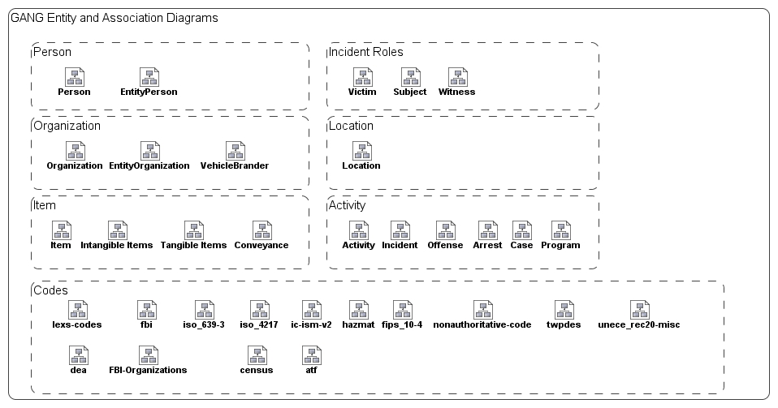
Diagrams of NIEM concepts

Slide 64
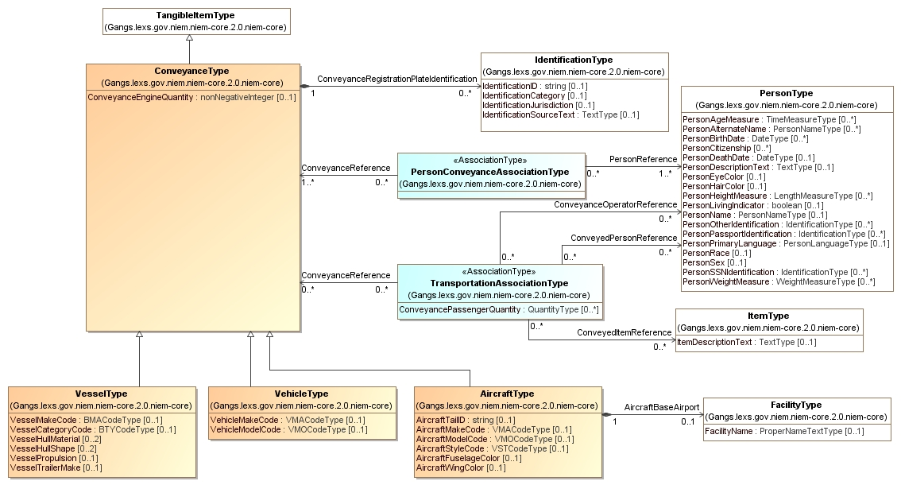
Conveyance Detail

Slide 65
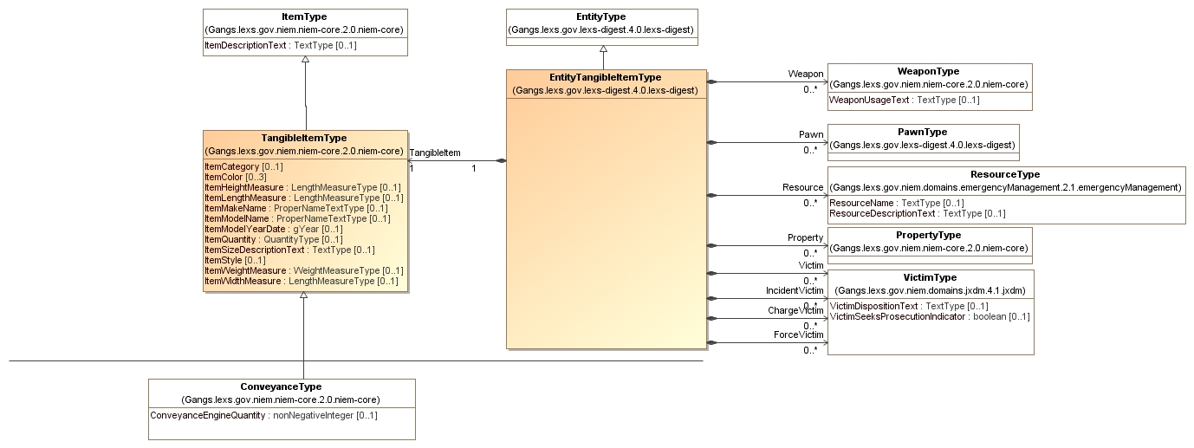
Explore to Related Type
Others…

Slide 66
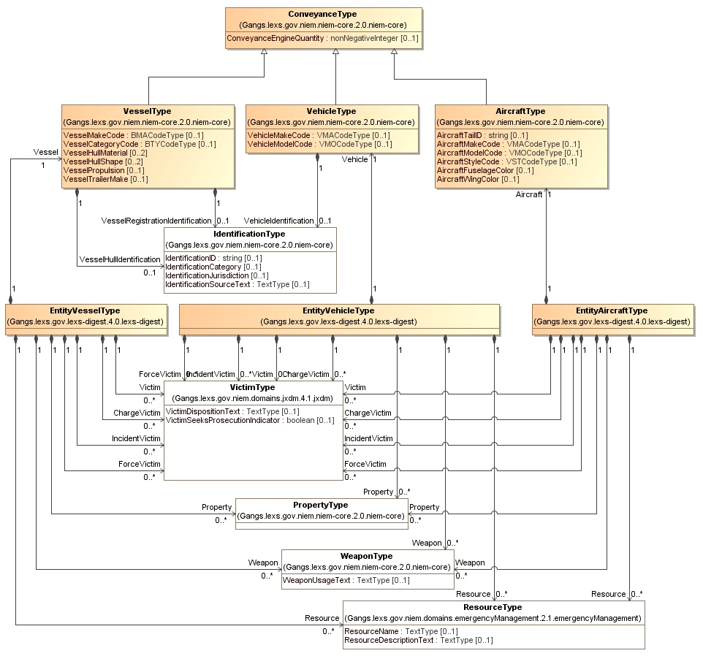
Why
This
Redundant
Complexity?

Slide 67
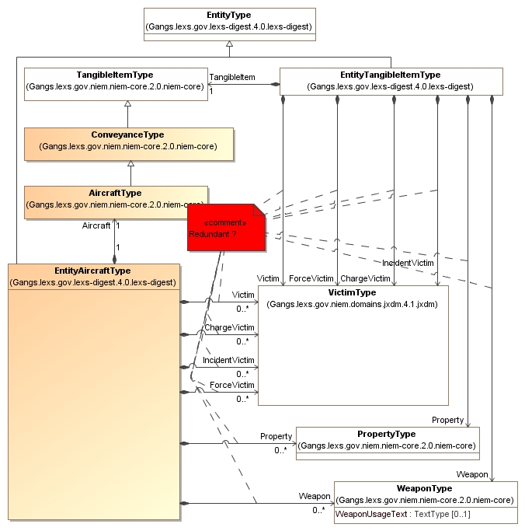
Issues in model
presented for stakeholders

Slide 68
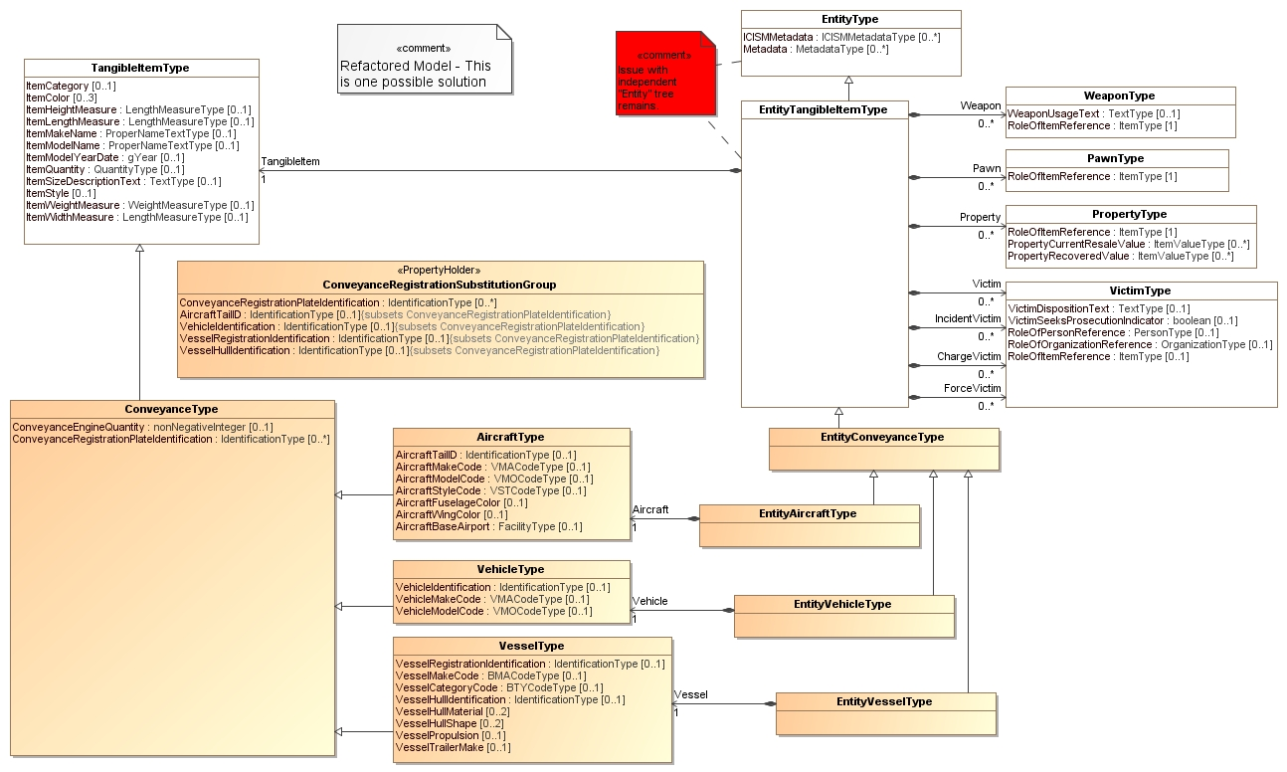
Refactored Model

Slide 69
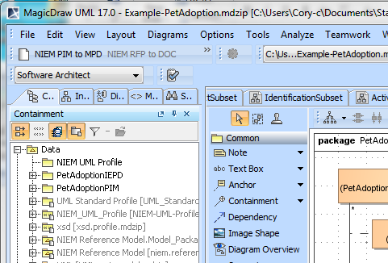
Create the XSD & Documentation from the model
You then tell your UML and/or MDA tool to make the NIEM XML Artifacts

Slide 70
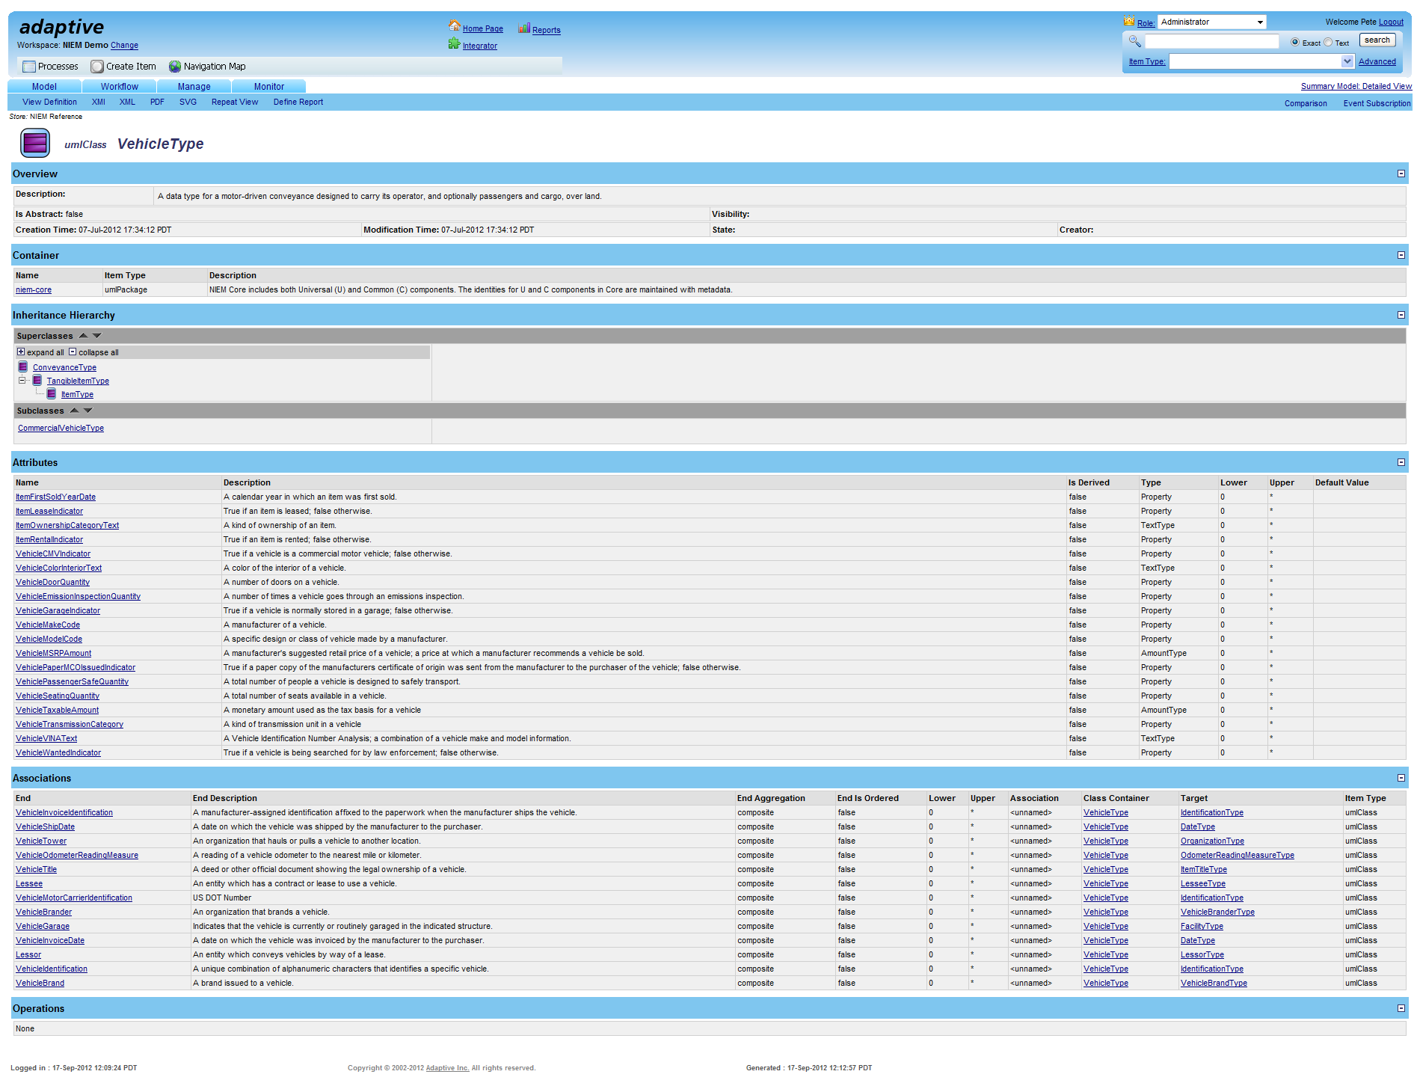
Repository view for community interaction

Slide 71
Model driven Process Is:
Visual
More Understandable (but not simplistic)
Collaborative
Manageable & Traceable
Automated

Slide 72
Information on NIEM-UML
http://niem-uml.org
Information on Magicdraw’s Cameo NIEM-UML Product
http://www.nomagic.com/products/magicdraw-addons/cameo-niem-plugin.html
Notes:
Thank you for your interest in NIEM-UML
Additional information and more tutorials are available on niem.gov and niem-uml.org

